Slide 1

Helpdesk SLA Performance Report
Analysis & Recommendations

Slide 2
Overview of dataset:
1.Ticket Number: Unique identifier for each helpdesk ticket.
2.Date Created: Timestamp when the ticket was created.
3.Subject: Brief description of the issue.
4.From & From Email: Name and email of the requester.
5.Priority: Urgency level (e.g., Emergency, High, Medium, Low).
6.Department: The department handling the request.
7.Type: Nature of the issue (e.g., Incident / Problem).
8.Source: How the ticket was submitted (e.g., Web).
9.Current Status: Status of the ticket (e.g., Closed, Resolved).
10.Last Updated: The last time the ticket was modified.
11. Due Date: Expected resolution deadline.
12. Overdue: Whether the ticket is overdue (binary: 0 or 1).
13. Answered: Whether the ticket has been responded to (binary: 0 or 1).
14. Agent Assigned: Name of the assigned support agent.
15. Team Assigned: Support team handling the request.
16. Thread Count: Number of interactions in the ticket.
17. Attachment Count: Number of attached files.
18. Category: Classification of the issue (e.g., PROD for production issues).
19. Issue Origin: The origin of the issue (e.g., Production).
20. Select Ticket Status Update: The latest update on ticket status.

Slide 3
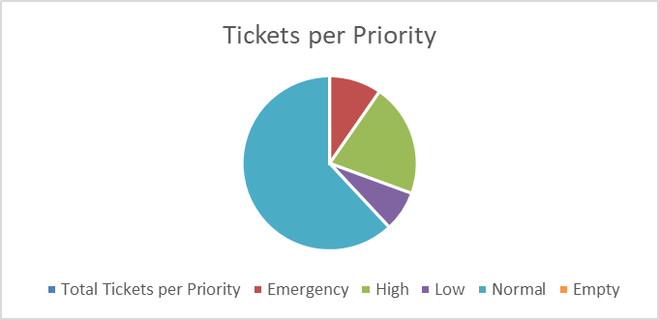
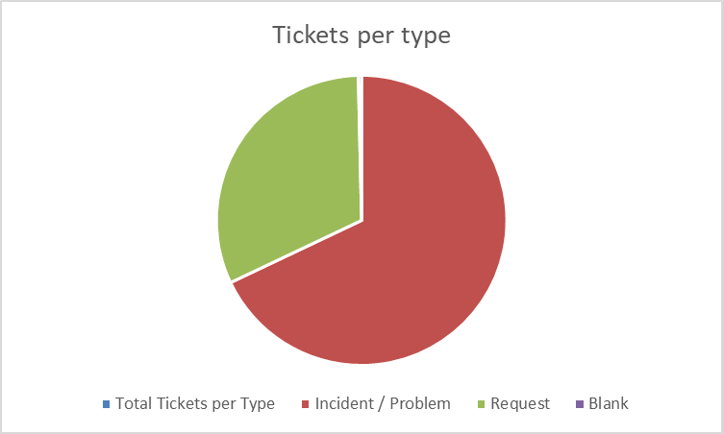
Data summary:
Total Tickets per Priority – Categorizes tickets based on priority levels (e.g., Emergency, High, Normal, Low).
Total Tickets per Type – Groups tickets by type, such as Incident/Problem and Request.

Slide 4
Data summary:
Total Tickets per Current Status – Shows ticket distribution by status, including Open, Resolved, and Closed tickets.
Total Tickets per Current Status – Shows ticket distribution by source, including Email, Web and Phone.

Slide 5
Dataset Summary:
Total Tickets per Team – Displays the total number of tickets handled by different teams.

Slide 6
Observations:
Missing Values:
Some columns have missing values, such as Type (2 missing), Team Assigned (2 missing), Issue Origin (2 missing), and Select Ticket Status Update (4 missing).
Data Types:
Datetime fields: Date Created, Last Updated, and Due Date are datetime fields.
Categorical Priority: Department, Status, and Category are categorical.
Numerical: Overdue, Answered, and Attachment Count are numerical.

Slide 7
Objectives:
Analyze ticket volume and prioritization trends.
Assess SLA compliance and identify delays.
Highlight common challenges affecting resolution times.
Recommend strategies to improve SLA adherence and overall efficiency.

Slide 8
Balancing resource allocation across different priority levels is crucial.
Key Findings:
Total Tickets Logged: 549
Emergency Tickets: 53
High-Priority Tickets: 115
Normal-Priority Tickets: 340
Low-Priority Tickets: 41
Recommendations:
Automate ticket categorization based on priority.
Implement escalation workflows to ensure high-priority tickets are addressed first.
Optimize team workload distribution to prevent backlogs.

Slide 9
SLA Performance Analysis
Findings:
Certain priority levels may be experiencing delays due to resource constraints.
Resolution time inconsistencies across different ticket categories.
High percentage of unresolved or overdue tickets leading to SLA breaches.
Recommendations:
Implement real-time SLA monitoring dashboards.
Regularly review unresolved ticket logs to identify systemic delays.
Set up automated reminders and escalations for tickets nearing SLA deadlines.

Slide 10
Key Challenges Affecting SLA Compliance:
Challenges:
High Ticket Volume – Large volumes of incidents are leading to backlogs.
Delayed Response Times – High-priority tickets not being acknowledged within SLA timeframes.
Lack of Automation – Manual ticket assignment and categorization slow down resolution.
Resource Constraints – Insufficient staffing to handle urgent cases effectively.
Recommendations:
Implement chatbots or automated response systems for quicker ticket acknowledgment.
Improve ticket triaging processes to allocate resources efficiently.
Invest in knowledge management tools for faster troubleshooting.

Slide 11
Recommendations for SLA Improvement
Process Improvements:
Automate ticket categorization and workflow management.
Introduce tiered support teams to handle different priority levels.
Regular SLA performance reviews to identify areas for improvement.
Technology Enhancements:
Implement AI-driven ticket routing to assign tickets based on urgency and expertise.
Use real-time dashboards to track SLA compliance.
Enable self-service portals to reduce ticket volume by allowing users to resolve minor issues independently.
Staffing & Training:
Provide SLA awareness training for support teams.
Allocate dedicated resources for emergency and high-priority tickets.
Establish knowledge-sharing platforms to improve issue resolution speed.

Slide 12
Thank you

